Slide 1
WEB Technologies (CS-566)
LECTURE # 4 & 5– HTML Links and Navigation

Slide 2
Outline
How to link between pages of your site (internal links)
How to link to other sites (external)
Link Attributes

Slide 3
HTML Links

Slide 4
HTML Links
HTML has capability to reference countless other pieces of information easily on the internet.
Syntax: <a href="url">link text</a>
The most important attribute of the <a> element is the href attribute, which indicates the link's destination.
The link text is the part that will be visible to the reader.
When you link to another page in your own web site, the link is known as an internal link/relative url.
When you link to a different site, it is known as an external link/absolute url.

Slide 5
Internal Links
The element <a> is used to link another document.
Anything between opening <a> tag and the closing </a> tag becomes part of the link that users can click in a browser.
To link another page, href attribute of opening tag of <a> is used
The value of the href attribute is the name of the file you are linking to
For example:
<a href=“abc.html”> Click here </a>

Slide 6
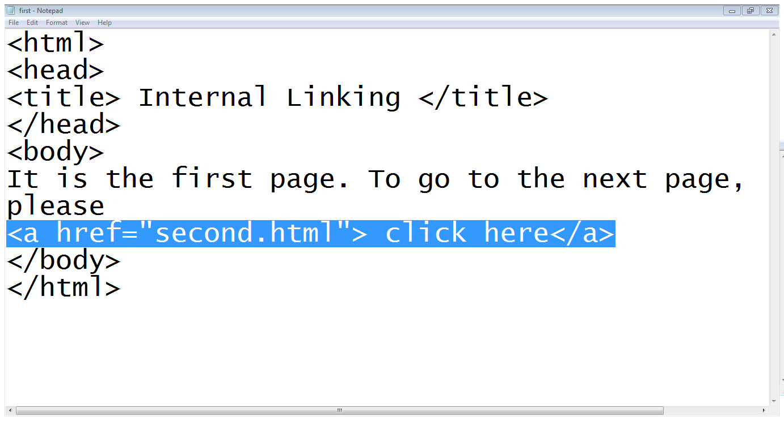
Example

Slide 7
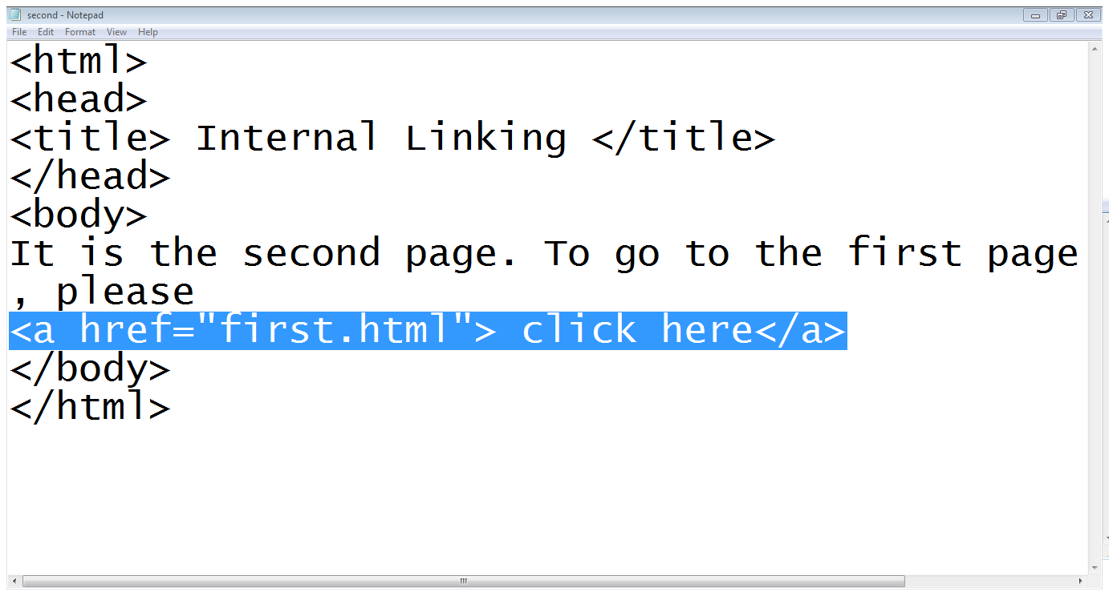
Cont…

Slide 8
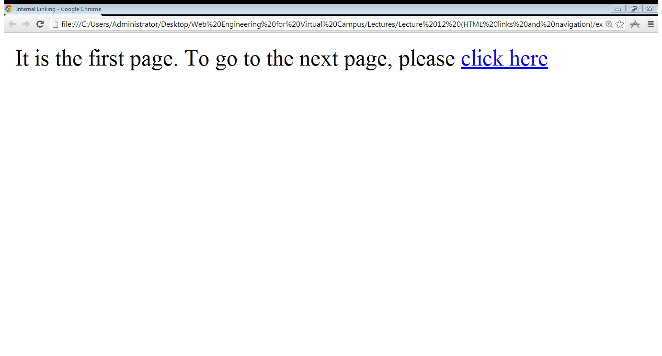
Output

Slide 9
External Links
To link the page of another website, again the href attribute of opening tag of <a> is used.
The value of the href attribute is the full web address for the page you want to link to rather than just the filename.
<a href="https://www.google.com.pk"> Click here </a>
<a href="https://www.w3schools.com/">Visit W3Schools.com!</a>

Slide 10
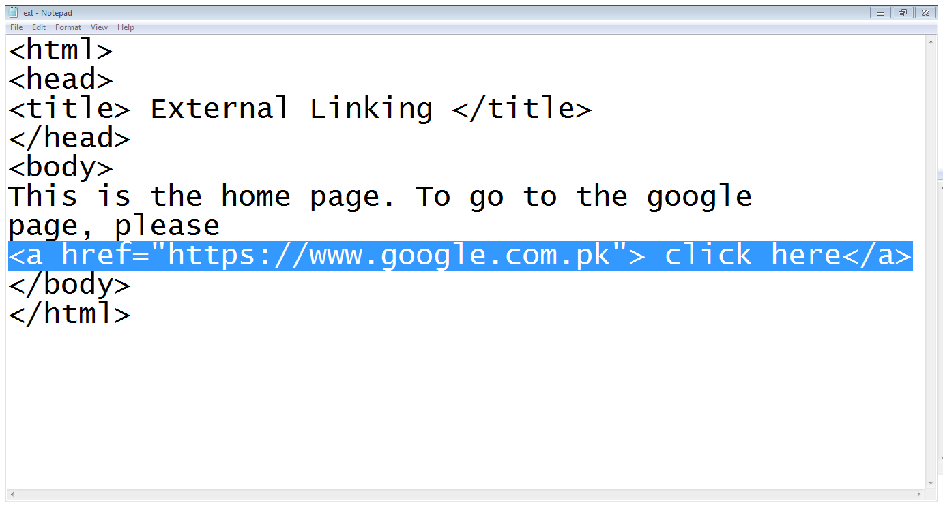
Example

Slide 11
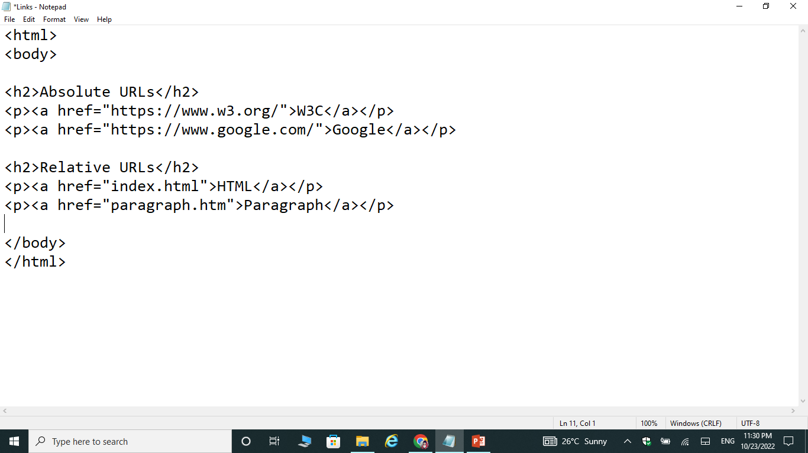
Cont…

Slide 12
Attributes for <a> access
Tab index:
<a href=“abc.html” tabindex=“1”>….</a>
The tabindex attribute specifies the tab order of an element (when the "tab" button from keyboard is used for navigating).
Target:
By default, the linked page will be displayed in the current browser window. To change this, you must specify another target for the link.
<a href=“abc.html” target=“_blank”>….</a>
Title:
<a href=“abc.html” title=“it’s a link”> Click</a>

Slide 13
Email:
<a href="mailto:someone@example.com">Send email</a>
Button:
<button onclick="document.location=‘index.html'">HTML</button>
Image:
<a href=“links.html”> <img src=“wt.jpg" alt="HTML tutorial" height=“100” width=“100”style="width:42px;height:42px;"> </a>

Slide 14
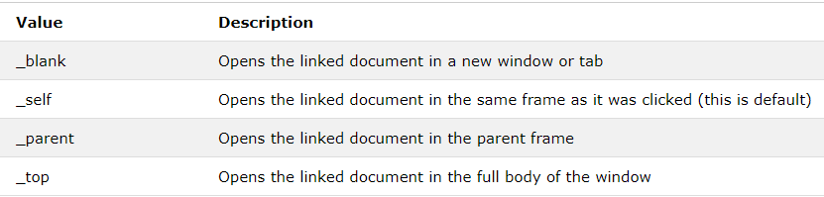
Cont…
Target: <a href=“abc.html” target=“_blank”>….</a>

Slide 15
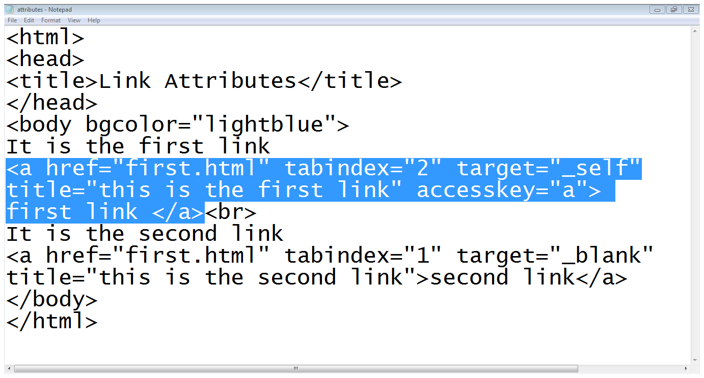
Example

Slide 16
Exercise Questions

Slide 17
Exercise Questions
Add a Background color by using “bgcolor”, also use different external links.
Try different examples of attributes for <a> access.

